Slide 1
Wireless Mesh Networks: Issues and Solutions from Wireless Mesh networking by Y. Zhang
Myungchul Kim
mck@kaist.ac.kr

Slide 2
Introduction
  Advantages
    Fault tolerance against network failures
    Simplicity of setting up
    Broadband capability
  Full or Partial mesh topology -> multihop relaying
  MANET for high mobility multihop environment vs WMN for a static or limited mobility environment
  Single-radio vs Multi-radio WMNs (MR-WMNs)

Slide 3
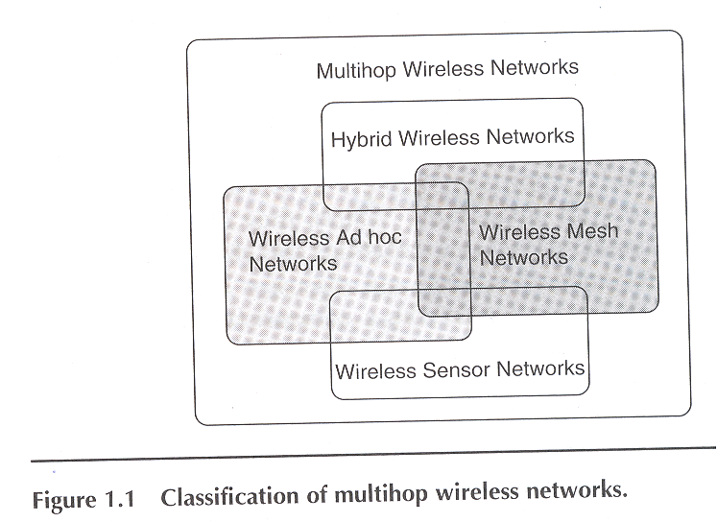
Comparison between MANET and WMN
  On-demand routing protocols in MANET and static hierarchical or table-driven routing protocols in WMN

Slide 4
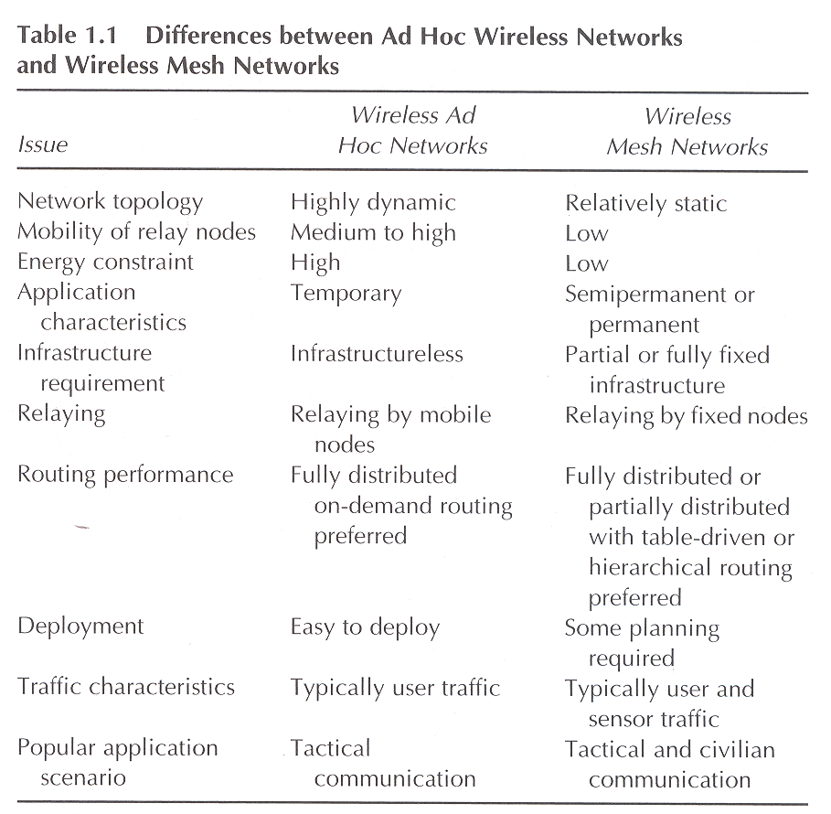
Comparison between MANET and WMN

Slide 5
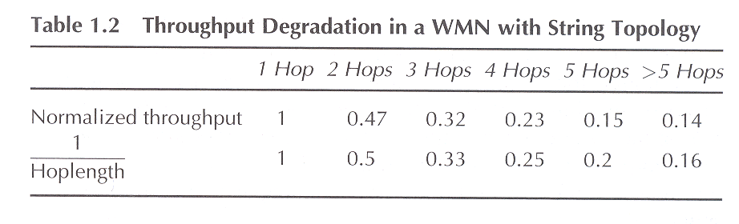
Challenges in WMNs
Limited network capacity
  MANET: Θ (1/√n log n) where n is the number of nodes in the network
  WMN: Θ (W * n ^{-1/d}) where d is the dimension of the network and W is the total bandwidth
  The throughput capacity can be significantly increased by the use of multiple interfaces
Throughput capacity (single radio)

Slide 6
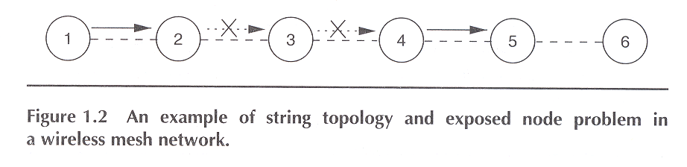
Challenges in WMNs

Slide 7
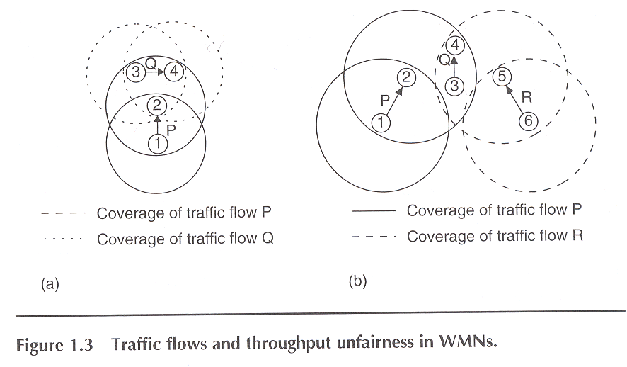
Challenges in WMNs
Throughput fairness
  A single-radio WMN -> high throughput unfairness
  CSMA/CA-based MAC protocols
    Information asymmetry
    Location-dependent contention
    Half-duplex character of single-channel systems

Slide 8
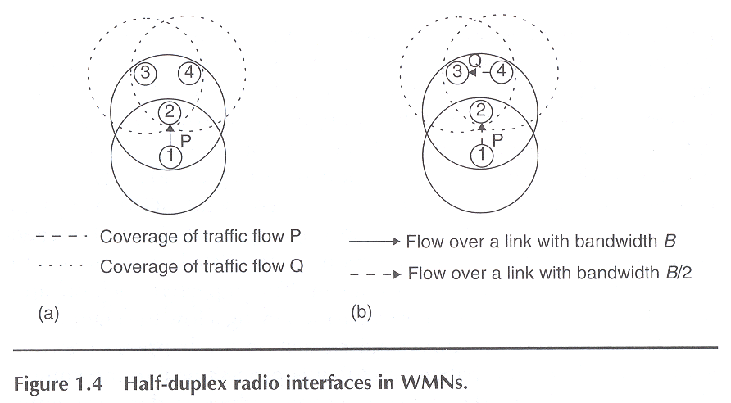
Challenges in WMNs
The flow P receives about 5% of the total throughput compared with the 95% throughput achieved by flow Q.
The Flow Q receives only 28% of the total throughput compared with 36% throughput shared received by both the flows P and R.
Due to the half-duplex characteristics, no node can simultaneously receive and transmit.

Slide 9
Challenges in WMNs
Reliability and robustness
  WMN utilizing unlicensed frequency spectrum: single radio -> multiple radio
Resource management
  Efficient management of network resources such as energy, bandwidth, interfaces, and storage
  Load balancing across multiple interface

Slide 10
Design issues in WMNs
Network protocol design issues
  Physical layer
    CDMA, UWB, MIMO over OFDM
    Programmable radios or cognitive radios
    Economic considerations
  MAC layer
    Heavily related with network capacity
    CSMA/CA issues: hidden terminal problem, exposed terminal problem, location-dependent contention, high error probability on the channel
    New MAC for MR-WMN
    Cross-layer design

Slide 11
Design issues in WMNs
  Network layer
    Table-driven or on-demand routing approaches
    Issues: routing metric, minimal routing overhead, route robustness, effective use of support infra, load balancing and route adaptability
  Transport layer
    Large RTT variations
    Issues: end-to-end reliability, throughput, capability to handle network asymmetry, and capability to handle network dynamism.
  Application layer
    Internet access and VoIP
    Service discovery

Slide 12
Design issues in Multiradio WMNs
Medium access control design issues
  interchannel interference: 802.11b has 11 unlicensed channels, only 3 of them (channels 1, 6, and 11) can be used simultaneously at any given geographical location
  interradio interference occurs even when both the interfaces use nonoverlapping channels
  channel allocation: channels and interfaces -> coloring problem
  MAC protocol design
    Multichannel CSMA
    Interleaved CSMA
    2P-TDMA

Slide 13
Design issues in Multiradio WMNs
Routing protocol design issues
  Routing topology
    Flat routing protocol
    Hierarchical routing protocol
  Use of a routing backbone
    Tree-based backbone routing
    Mesh-based backbone routing
    Hybrid topology routing
  Routing information maintenance approach
    Proactive or table-driven routing protocols: DSDV, WRP, STAR
    Reactive or on-demand routing protocols: AODV, DSR, MRLQSR
    Hybrid routing protocols: ZRP

Slide 14
Design issues in Multiradio WMNs
Routing metric design issues
  A routing metric is the routing parameter, weight, or value that is associated with a link or path, based on which a routing decision is made.
  Hop count
  Should take factors such as
    Network architecture
    Network environment: location dependent contension, BER, …
    Extent of network dynamism due to mobility
    Basic characteristics of the routing protocol: nonisotonic = freedom from routing loops

Slide 15
Link layer solutions for MRWMN
The lack of network scalability in a WMN
  Half-duplex character of the radio
  Inefficient interaction between the network congestion and the protocol stack
  Collision due to hidden terminal problem
  Resource wasted due to exposed terminal problem and location-dependent contention
  Difficulties in handling a multi-channel system
Challenges
  Adjacent radio interferences
  Dynamic management of spectrum resources
  Efficient management of multiple radio interfaces.

Slide 16
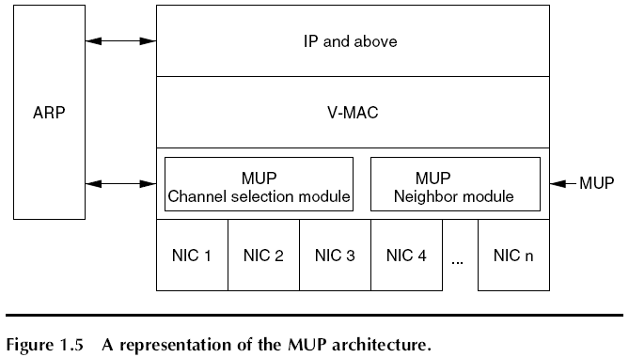
Link layer solutions for MRWMN
Multiradio Unification Protocol (MUP)
  Goals
    Minimize the hw modifications
    Avoid making changes to the higher layer protocols
    Operate with legacy (non-MUP) nodes
    Not depend on the global topology information
    Fig 1.5

Slide 17
Link layer solutions for MRWMN
    MUP uses a virtual MAC address concealing the multiple physical address.
    Selection of radio interfaces: MUP-random and MUP-Channel Quality schemes
    Two modules: a neighbor module and a channel selection module
    The MUP neighbor table in the neighbor module
      Node id
      MUP status
      MAC address list
      Channel quality list
      Preferred channel id
      Selection time
      Packet time
      Probe time list

Slide 18
Link layer solutions for MRWMN
    Channel quality is measured -< High priority for probe packets using 802.11e
      Smoothed round-trip time (SRTT) = β * RTT + (1- β) * SRTT where RTT is the round-trip time of the most recent MUP-CS(channel select)-MUP-CSACK exchange.
    Adv.
      Work with legacy nodes
      Remove the higher protocol layers from knowing the complexities in handling multiple radio interface
      Improves the spectrum efficiency and system throughput
    Disadv.
      Coarse channel assignment
      The prioritized queuing for the probe packets unavailable
      Suboptimal wrt global resource usage
      Orthogonal channel assignment

Slide 19
MAC protocols for MRWMN
Multichannel CSMA MAC
  Similar to an FDMA
  Non-overlapping n+1 channels: n data channels and a control channel
  Free channel list: when a channel is idle for sufficient amount of time, it is added to the free channel list
  If the most recently used channel is already present in the free channel list, …
  If the free channel list is empty, waits for a channel to be idle.
  The scheme alleviate the exposed terminal problem and permits simultaneous packet transmission sessions waiting the broadcast region.

Slide 20
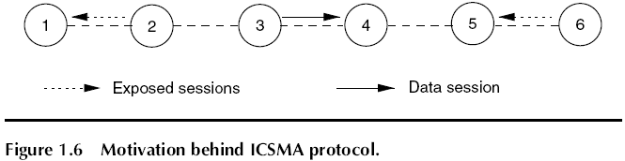
MAC protocols for MRWMN
Interleaved CSMA
  Exposed terminal problem in the single-channel CSMA
  Fig 1.6
  Node 2: sender-exposed,
  Node 6: receiver-exposed (acknowledgement)

Slide 21
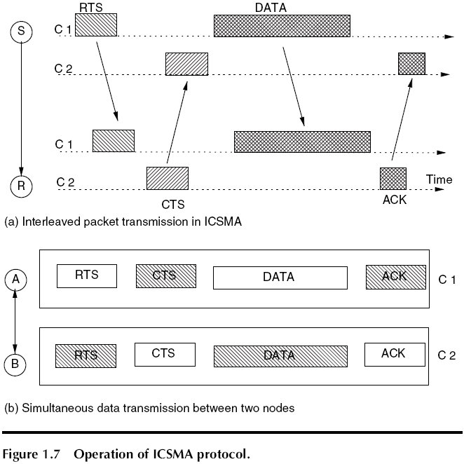
MAC protocols for MRWMN
  ICSMA: two channel-system
  Fig 1.7

Slide 22
Routing protocols for MRWMN
New routing metrics for MRWMN
  Factors affecting routing performance
    Relay-induced load
    Asymmetric wireless links
    High link loss
  Expected transmission count (ETX) based on
    Packet delivery ratio of each link
    Asymmetry of the wireless link
    Min number of hops
  ETX of an end-to-end path is defined as the sum of the ETX of each of the links in that path.

Slide 23
Routing protocols for MRWMN
  ETX of a link: ETX = 1 / FDR*RDR where the denominator represents that expected probability of a successful data packet transmission and the ACK packet transmission.
  The packet delivery rate
  = Probe_count (P _{window}) / (P _{window} / T)
  where P _{window} = 10 * T and short probe packet once every T seconds.
  Random jitter is added to the periodicity of the probe packet to avoid the possible synchronization of probe packet transmission schedule

Slide 24
Routing protocols for MRWMN
  Disadv
    When the traffic load is high
    Adding a separate queue for the probe packets -> interoperability
    When nodes are mobile

Slide 25
Routing protocols for MRWMN
Multiradio Link Quality Source Routing
  An extension of the DSR
  Weighted cumulative expected transmission time (WCETT)
  Modules
    A neighbor discovery
    Link weight assignment
    Link weight information propagation
    Pathfinding
  The expected transmission time depends on the link data rate and the packet loss rate.

Slide 26
Routing protocols for MRWMN
Multiradio Link Quality Source Routing
  Design philosophy of WCETT
    Loss rate and the bandwidth of a link
    A nonnegative link cost
    Consideration of the cochannel interference

Slide 27
Routing protocols for MRWMN
  WCETT = (1 - α) * ∑ ^{L} _{i=1} ETT _{i} + α * max _{1 ≤j ≤ k} T _{j} where ETT _{i} is the expected transmission time of link i in a path of length L and T _{j} is the sum of the transmission times on a particular channel j.
  The end-to-end delay factor + the channel diversity factor (bottleneck links)
  Tj = All 1 ≤j ≤ k ∑ _{Link i of L uses channel j} ETT _{i} where k is the number of channels in the system and L is the path length.
  ETT = ETX * S / B where S packet length and B the bandwidth of the link

Slide 28
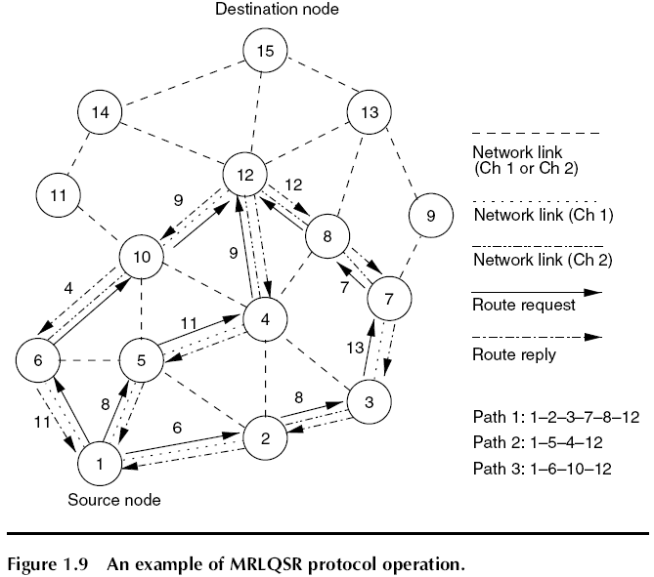
Routing protocols for MRWMN
  Fig 1.9

Slide 29
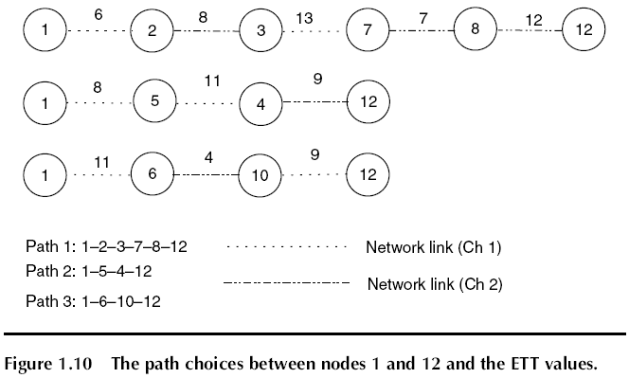
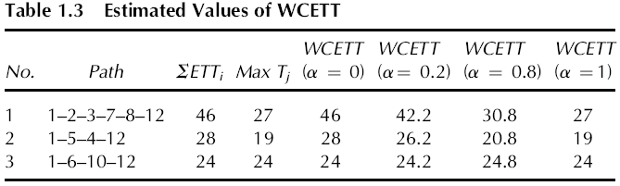
Routing protocols for MRWMN
  Fig 1.10 and Table 1.3

Slide 30
Routing protocols for MRWMN
  WCETT outperforms ETX by about 80% on testbed
  At high network load, lower value of α provides better network throughput
  Disadv
    Channel interference on neighbor links
    Cause loop formation

Slide 31
Routing protocols for MRWMN
Load-aware infererence balanced routing protocol
  The metric of interference and channel-swithing (MIC)
  Intraflow and interflow interferences
  MIC_{k} = ∑ _{node j belonging path k} C_{cs} ^{j} + IFF * ∑ _{link i belonging k} IRU _{i} where channel switching C_{cs} and IFF refers to the interflow interference normalization factor for a network having N _{T} number of nodes and is estimated as IFF = 1 / (N _{T} * MIN (ETT))
  Disadv
    Isotonicity?
    High overhead due to obtain the total number of nodes in the network
    How to estimate the min value of ETT in the network -> scalability

